Slide 1




Business Risk Management
Enron North America
SAP Controls Project
Project Timeline
May 1, 2000

Slide 2
Process Flow
Enron North America
Scope of Work
Process &
Functions
Outside
SAP
Custom
Business Unit
Processes &
Functions
Standard SAP
Processes &
Functions
(Common Design)
Custom
Business Unit
Processes &
Functions
Process &
Functions
Outside
SAP
Overall Process Flow
Outside SAP - Manual processes or processes handled by another application.
Custom Processes & Functions - SAP functions customized to meet the needs of the business process.
Standard SAP Processes & Functions - Standard processes that are delivered by SAP.

Slide 3
Process Components
Enron North America
Process Review
  Meet with affected process owners to verify common control design and identify gaps
  Make appropriate changes to existing process maps
  Attend Functional testing to observe functioning of critical controls
  Facilitate resolution of expectations gaps related to controls
Proposed In Scope
  Detail Review & Analysis
  A/P and Cash Disbursements
  A/R and Cash Receipts
  Bank Accounts and EDI
  Intercompany Transactions
  High Level Review to Determine Extent
  of Utilization
  Cash Flow Forecasting and Reporting
  Planning and Budgeting
  Cost Center Reporting and Allocation
Out of Scope
  Capital Budgeting
  Cash Management and Investments
  Asset Acquisition to Retirement
  Inventory Management
  Purchasing and Procurement
  Project Definition Through Close
  Human Resources

Slide 4
Technical Components
Enron North America
Interfaces
  Meet with SAP team / legacy system developers to identify interface flow and controls
  Map interfaces with risk / control points
  Observe functional testing to ensure functioning of critical controls
  Report progress of interface accuracy and success throughout test cycles
  Proposed In scope
  745.D Unify AP Invoices to SAP
  838.D SAP Intercompany AP Invoice to Unify
  744.D Unify AR Invoices to SAP
  761.D Unify Intercompany AR-AP Invoice to SAP
  800.D Lockbox - Bank of America TX
  874.D Check Printing for ENA - Canada (C0293)
  791.D Unify AR-AP Accrual & Reversal to SAP
  849.D SAP to Credit Aggregation System
  Out of Scope
  783.D EBS-Canada
  799.D EBS-Citibank NY Citibank DE Bank of America TX
  873.D CBM to CS by Profit Center (C0293)
  775.D HL&P Utility Invoice (AP)
  776.D SW Public Service Utility Invoice (AP)
  777.D Arizona Public Service Utility Invoice (AP)
  837.D PHH Cindant MasterCard to SAP
  843.D Interfacing GPG & ENA Data Existing Interfaces
  351.D SAP Payment info to Unify

Slide 5
Technical Components - Contd.
Enron North America
Conversions
  Meet with SAP team to identify converted data and verify conversion structure
  Assess conversion adherence to standard controls
  Proposed In Scope
  763.D SAP Extend AP Vendor Master Data
  738.D MSA AR Open Items to SAP
  737.D Unify AR Open Items to SAP
  811.D GL Balance Conversion (Enron - N/A)
  842.D GL Balance Conversion (Enron - Canada)
  819.D Asset Master Load (Enron - N/A)
  Out of Scope
  765.D SAP Employee Receivables Account Group Open
  767.D HR Master Data Employee Rec to SAP
  815.D PS/IO Balance Conversion (Enron - N/A)
  806.D Work Center Create/Change - Enron - N/A
  807.D Project /WBS Create/Change - Enron - N/A
  808.D Network Activity Create/Change - Enron - N/A

Slide 6
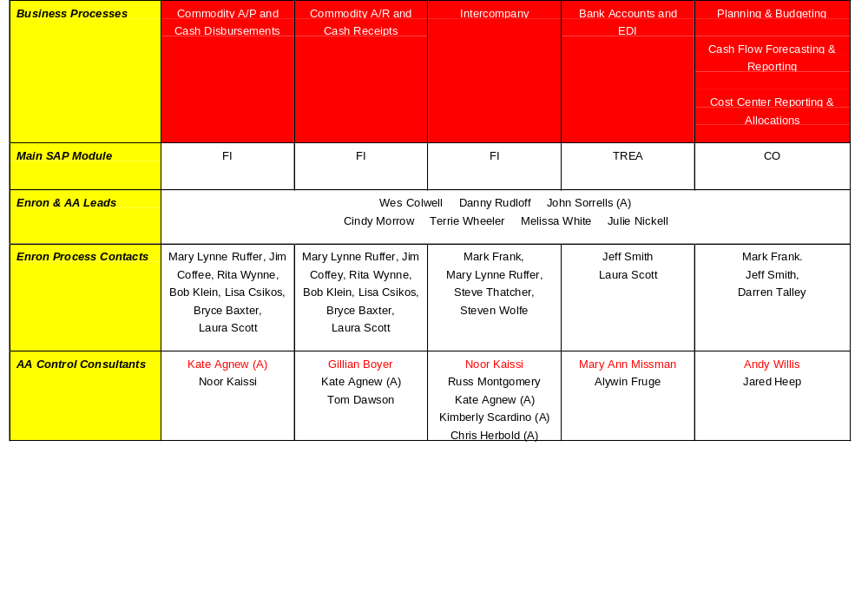
Process Project Team
Enron North America
(A) Involved at a high level to ensure leverage of business knowledge

Slide 7
Project Timeline
Enron North America
Deliver formal written results to site manager and process owners
System Lock-down Scope Completion
“Go Live”
May
1
FIT 2
June
1
FIT 3
July
1
Roles Review -
Kate Agnew, Carrie Applewhite
Compare listing of incompatible roles
with current listing of ENA roles
Communicate issues to site manager,
corporate coordinator and security
administrator
Conduct follow-up on issues resolution
Account Mapping -
Kate Agnew, Craig Wescott
Obtain and review system exception
reports to verify completeness and
accuracy of account mapping
Resolve account mapping
exceptions and discrepancies
Conduct follow-upon issue resolution
Canada Process Analysis -
Kate Agnew, Jared Heep
COMPLETE
COMPLETE

Slide 8
Project Timeline
Enron North America
Deliver formal written results to site manager and process owners
System Lock-down Scope Completion
“Go Live”
May
1
FIT 2
June
1
FIT 3
July
1
A/P and Cash Disbursements Process
Andy Willis
Noor Kaissi
Kate Agnew
Utilizing existing process model,
validate selected ENA business
processes. Analyze and prioritize
new business risks and controls
Identify and communicate process
“gaps” to site manager
Communicate process gap
analysis, issue resolution, and
formulate action plan
Conduct follow-up review to
ensure resolution of high-risk
issues were addressed

Slide 9
Project Timeline
Enron North America
Deliver formal written results to site manager and process owners
System Lock-down Scope Completion
“Go Live”
May
1
FIT 2
June
1
FIT 3
July
1
A/R and Cash
Receipts Process
Gillian Boyer
Kate Agnew
Tom Dawson
Utilizing existing process model,
validate selected ENA business
processes. Analyze and prioritize
new business risks and controls
Identify and communicate process
“gaps” to site manager
Communicate process gap
analysis, issue resolution, and
formulate action plan
Conduct follow-up review to
ensure resolution of high-risk
issues were addressed

Slide 10
Project Timeline
Enron North America
Deliver formal written results to site manager and process owners
System Lock-down Scope Completion
“Go Live”
May
1
FIT 2
June
1
FIT 3
July
1
Intercompany Process
Noor Kaissi
Russ Montgomery
Kate Agnew
Utilizing existing process model,
validate selected ENA business
processes. Analyze and prioritize
new business risks and controls
Identify and communicate process
“gaps” to site manager
Communicate process gap
analysis, issue resolution, and
formulate action plan
Conduct follow-up review to
ensure resolution of high-risk
issues were addressed

Slide 11
Project Timeline
Enron North America
Deliver formal written results to site manager and process owners
System Lock-down Scope Completion
“Go Live”
May
1
FIT 2
June
1
FIT 3
July
1
Bank Accounts and
EDI Process
Mary Ann Missman
Alywin Fruge
Utilizing existing process model,
validate selected ENA business
processes. Analyze and prioritize
new business risks and controls
Identify and communicate process
“gaps” to site manager
Communicate process gap
analysis, issue resolution, and
formulate action plan
Conduct follow-up review to
ensure resolution of high-risk
issues were addressed

Slide 12
Project Timeline
Enron North America
System Lock-down Scope Completion
“Go Live”
April
24
FIT 2
June
1
FIT 3
July
1
Unify Interfaces -
Bobby Joseph
Kevin Kosub
Meet with SAP and Legacy
developers
Document interface controls
Validate information
Monitor/communicate results

Slide 13
Project Timeline
Enron North America
System Lock-down Scope Completion
“Go Live”
April
24
FIT 2
June
1
FIT 3
July
1
Cash Interfaces -
Bobby Joseph
Tracey Judson
Meet with SAP and Legacy
developers
Document interface controls
Validate information
Communicate results

Slide 14
Project Timeline
Enron North America
System Lock-down Scope Completion
“Go Live”
April
24
FIT 2
June
1
FIT 3
July
1
Credit Interfaces -
Bobby Joseph
Kevin Kosub
Meet with SAP and Legacy
developers
Document interface controls
Validate information
Communicate results

Slide 15
Project Timeline
Enron North America
System Lock-down Scope Completion
“Go Live”
April
24
FIT 2
June
1
FIT 3
July
1
Conversions -
Bobby Joseph
Kevin Kosub
Tracey Judson
Meet with conversion team
leads
Review methodology
documentation
Review execution/conversion
documentation
Communicate Results

Slide 16
Key Business Observations
Enron North America
Reconciliation of cash application within SAP to primary account records maintained in Unify Settlements
Ensure system ability to properly net trade Accounts Receivable and Accounts Payable
Determine effective process for administering Prior Month Adjustments (PMAs)
Resolve segregation of duties and process issues with ECT- Canada
Ensure effective process design with regard to intercompany transactions

Slide 17
Process Timeline
Enron North America
Objectives
Roles Review
Compare listing of incompatible roles with current listing of ENA roles
Communicate issues to site manager, corporate coordinator and security administrator
Conduct follow-up on issue resolution
Account Mapping
Obtain and review system exception reports to verify completeness and accuracy of account mapping
Resolve account mapping exceptions and discrepancies
Conduct follow-up on issue resolution
Timeline
Complete
Complete
May 1 - May 5
May 3
May 4 - May 9
May 15 - May 19

Slide 18
Process Timeline
Enron North America
Objectives
Process Analysis
Validate selected processes. Analyze and prioritize new business risks and controls
Identify and communicate process “gaps” to site manager
Issue Resolution
Communicate written deliverable to site manager and process owners
Conduct follow-up review to ensure high-risk issues were addressed
Timeline
May 1 - May 17
May 17 - May 19
May 22 - June 30
June 2
June 19 - June 23

Slide 19
Project Timeline
Enron North America
Deliver formal written results to site manager and process owners
System Lock-down Scope Completion
“Go Live”
May
1
FIT 2
June
1
FIT 3
July
1
Roles Review - Kate Agnew, Carrie Applewhite
Compare listing of incompatible roles
with current listing of ENA roles
Communicate issues to site manager,
corporate coordinator and security
administrator
Conduct follow-up on issues resolution
Account Mapping - Kate Agnew, Craig Wescott
Obtain and review system exception
reports to verify completeness and
accuracy of account mapping
Resolve account mapping
exceptions and discrepancies
Conduct follow-upon issue resolution
Process Analysis
Utilizing existing process model, validate selected
ENA business processes. Analyze and prioritize new
business risks and controls
Identify and communicate process “gaps” to
site manager
Communicate process gap analysis, issue
resolution, and formulate action plan
Conduct follow-up review to ensure resolution of
high-risk issues were addressed
Canada Process Analysis -
Kate Agnew, Jared Heep
COMPLETE
COMPLETE

